Slide 1
Edge Computing
Md Masud Rana
Lecturer
Cyber Security Engineering Dept

Slide 2
What is Edge Computing
Edge computing optimizes internet devices (Desktop Computers, Mobile phones, Tablets, Smart TVs, Game Consoles, Wristwatches, Ebook readers, Digital Camera etc)and web applications by bringing computing closer to the source of the data. This minimizes the need for long distance communications between client and server, which reduces latency and bandwidth usage.
Notes:
Today any device can be web-enabled once equipped with appropriate connectivity (WiFi, 3G, 4G, 5G). The expansion of Android, and the lowered cost of hardware components, has made bringing connectivity to a device even easier and cheaper.

Slide 3
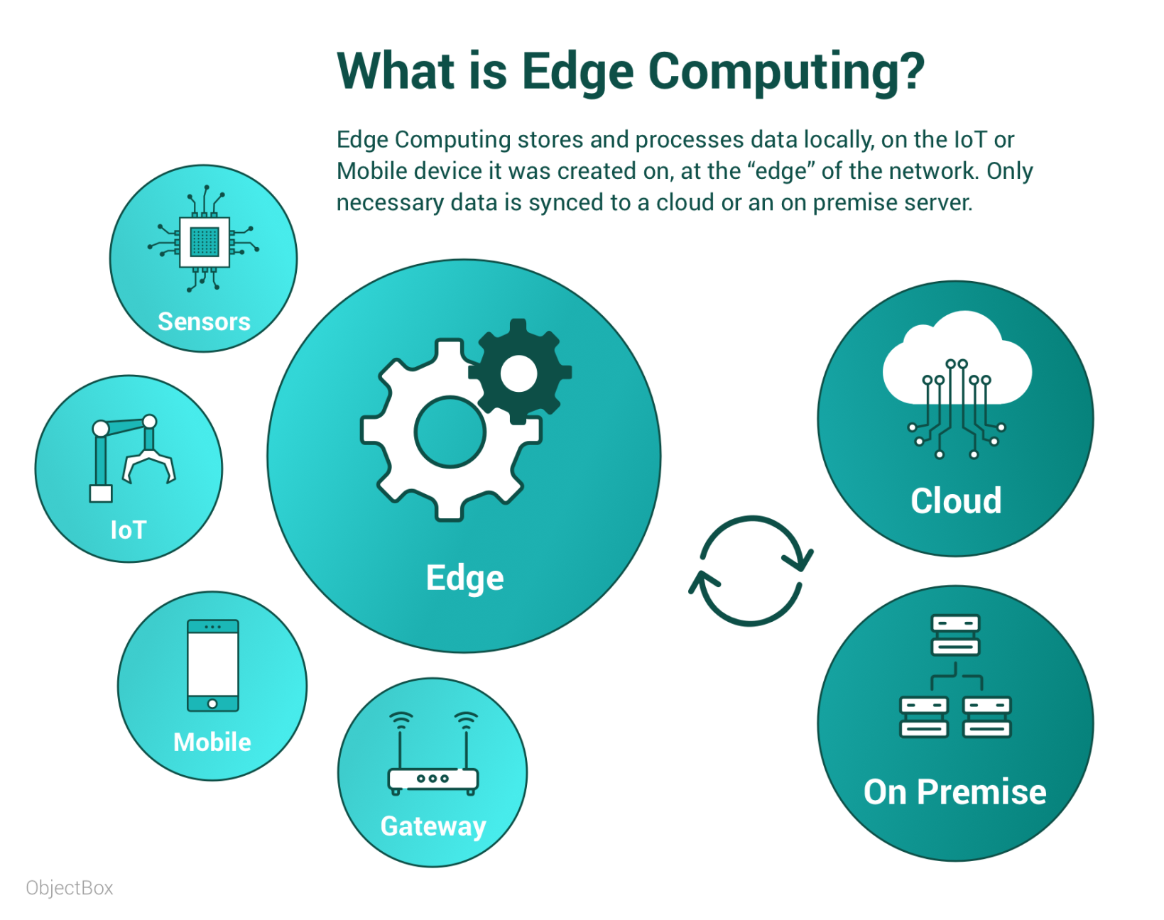

Slide 4
Overview
Edge Computing is a distributed computing paradigm in which processing and computation are performed mainly on classified device nodes known as smart devices or edge devices as opposed to processed in a centralized cloud environment or data centers.
It helps to provide server resources, data analysis, and artificial intelligence to data collection sources and cyber-physical sources like smart sensors and actuators.

Slide 5
What exactly is Edge Computing
A network of micro data centers that store or process critical data locally and push received data to a centralized data center or repository of cloud storage.
Typically in IoT use cases, a massive chunk of data goes through the data center, but edge computing processes the data locally results in reduced traffic in the central repository.

Slide 6
....Continue
This is done by IoT devices, transferring the data to the local device, which includes storage, compute, and network connectivity.
After that, data is processed at the edge while another portion is sent to storage repository or central processing in the data center.

Slide 7
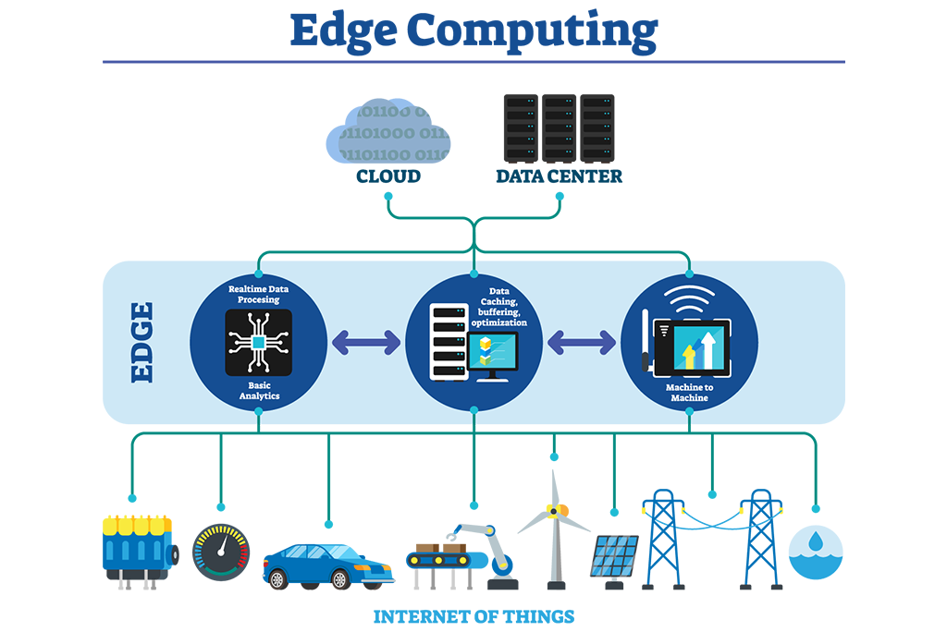

Slide 8
Edge Computing: The Telco View
Opportunity for providing edge computing devices in existing infrastructure • e.g., micro data centers at the base of cellular towers

Slide 9
Edge Computing: The Cloud Provider View
Goal is mainly to provide
Content Delivery Network (CDN) services
IoT data processing and aggregation for data in transit to the cloud

Slide 10
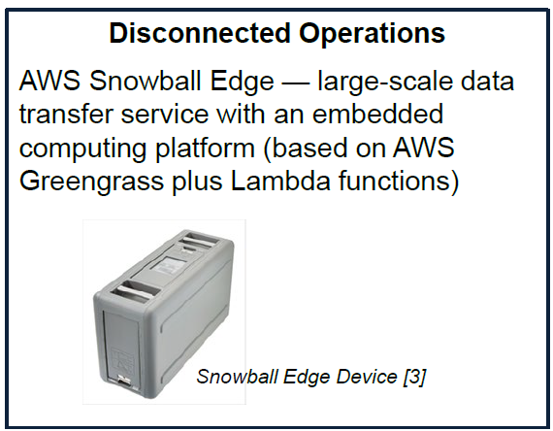
Edge Computing: The “Appliance” View
Goal is to provide a “data center in a box” to push cloud computing capabilities to the edge
Often combined with networking capabilities such as edge gateways and smart routers

Slide 11
Features
Computing at the edge of network
It focuses bringing computing as close to the source of data
It decentralizes processing power to ensure real-time processing without latency while reducing bandwidth and storage requirements on the network
It processes data locally at local network infrastructure instead sending all the data to the cloud data centre

Slide 12
Concept
Concept of Edge started dates back to 1990 when challenge of web traffic congestion was solved by introducing Content Delivery Network (CDN) solutions. The technology involved network nodes storing static cached media information at locations closer to end-users.
Edge computing takes this concept further, introducing computational capabilities into nodes at the network edge to process information and deliver services.
Notes:
A content delivery network (CDN) refers to a geographically distributed group of servers which work together to provide fast delivery of Internet content.

Slide 13
Edge Computing Terms
Edge
It highly depends on the use cases.
Like in telecommunication, it may be a cell phone or cell tower.
Similarly, in the automotive example, it could be a car.
In manufacturing, it could be a machine, and
In the Information Technology field, it could be a laptop.
Edge Devices
A device which produces data is edge devices like machines and sensors, or any devices through which information is collected and delivered.

Slide 14
Network Edge
It is the place where the device or the local network containing the device communicating with internet. E.g. a user’s computer or the processor inside of an IoT camera can be considered the network edge, but the user’s router, ISP, or local edge server are also considered the edge. The important takeaway is that the edge of the network is geographically close to the device, unlike cloud servers, which can be very far from the devices they communicate with.

Slide 15
IoT and Edge Computing
In IoT, with the help of edge computing, intelligence moves to the edge.
There are various scenarios where speed and high-speed data are the main components for management, power issues, analytics, and real-time need, etc. helps to process data with edge computing in IoT.

Slide 16
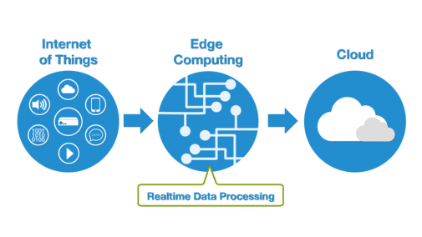

Slide 17
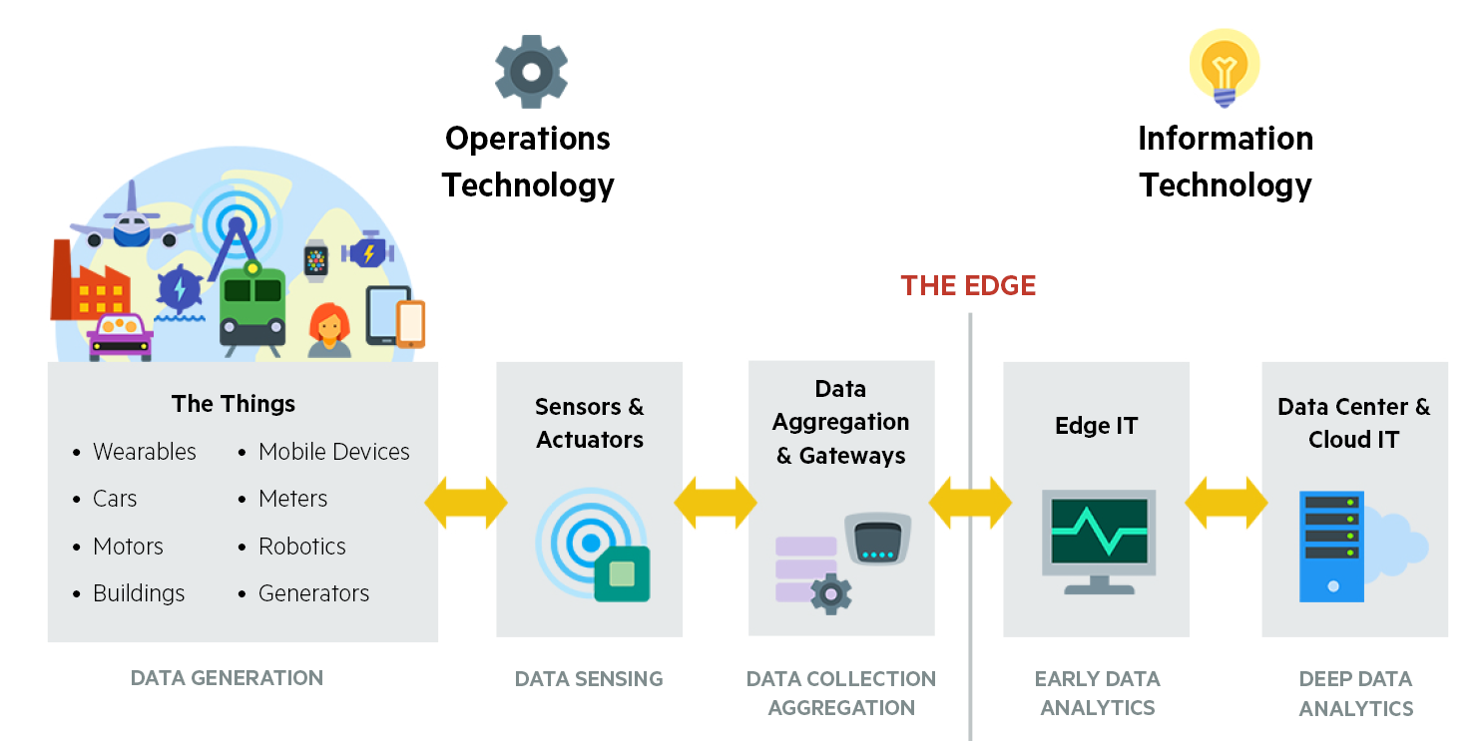

Slide 18
Cloud Computing vs. Edge Computing vs. Fog Computing
Edge Computing and Fog Computing are the extensions of Cloud Networks, which are a collection of servers comprising a distributed network.
Such networks allow organizations to exceed the resources that would be otherwise available to them.
The main advantage of cloud networks is that they allowed data to be collected from multiple sources, which is accessible anywhere over the internet.

Slide 19
....Continue
While Fog Computing and Edge Computing are almost similar, where the talk about intelligence and processing of data at the time of creation.
Fog Computing focus more on intelligence at local area network and this architecture transmits data from endpoints to a gateway where it is sent to sources for processing and return to transmission
while Edge Computing focus more on computing power and processing of data locally at the edge of a network.
It performs processing on embedded computing platforms interfacing to sensors and controllers.

Slide 20
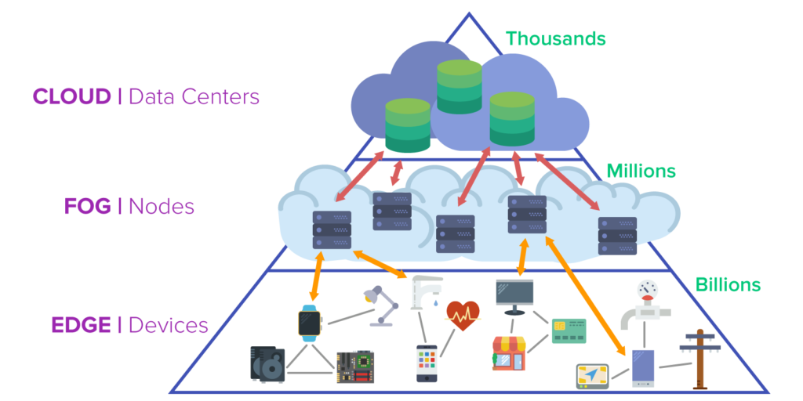

Slide 21
Why Edge Computing ?
When IoT devices have poor connectivity.
Not efficient for IoT devices to be in constant touch with the central cloud.
The latency factor reduces latency because data doesn’t have to traverse over a network to a central cloud for processing.
Where latencies are untenable like manufacturing or financial services.
As soon as data is produced, it doesn’t need to send over a network; instead, it compiles the data and sends daily reports to the cloud for long term storage, i.e., reduces the data traversing.
The buildout of the next-generation 5G cellular networks by telecommunication companies.
Direct access to gateway into the telecom provider’s network, which connects to a public IaaS cloud provider.

Slide 22
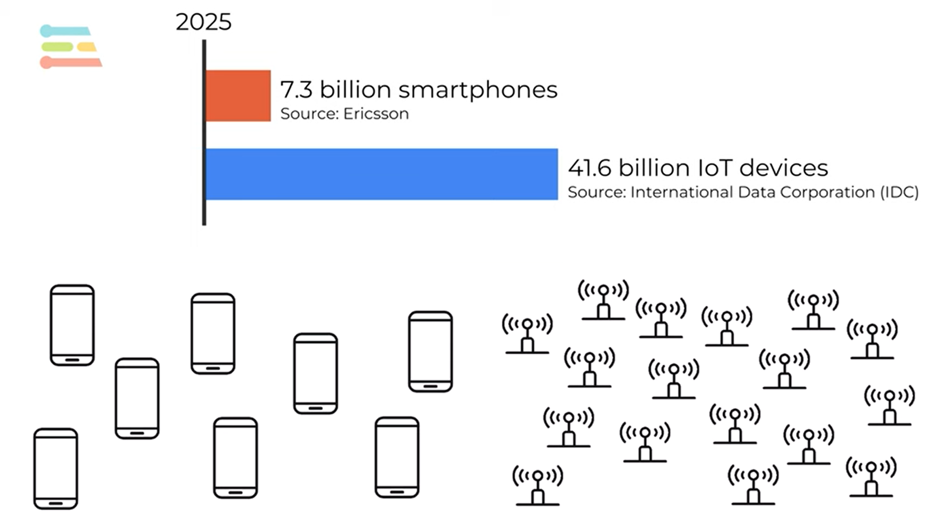
Why?

Slide 23
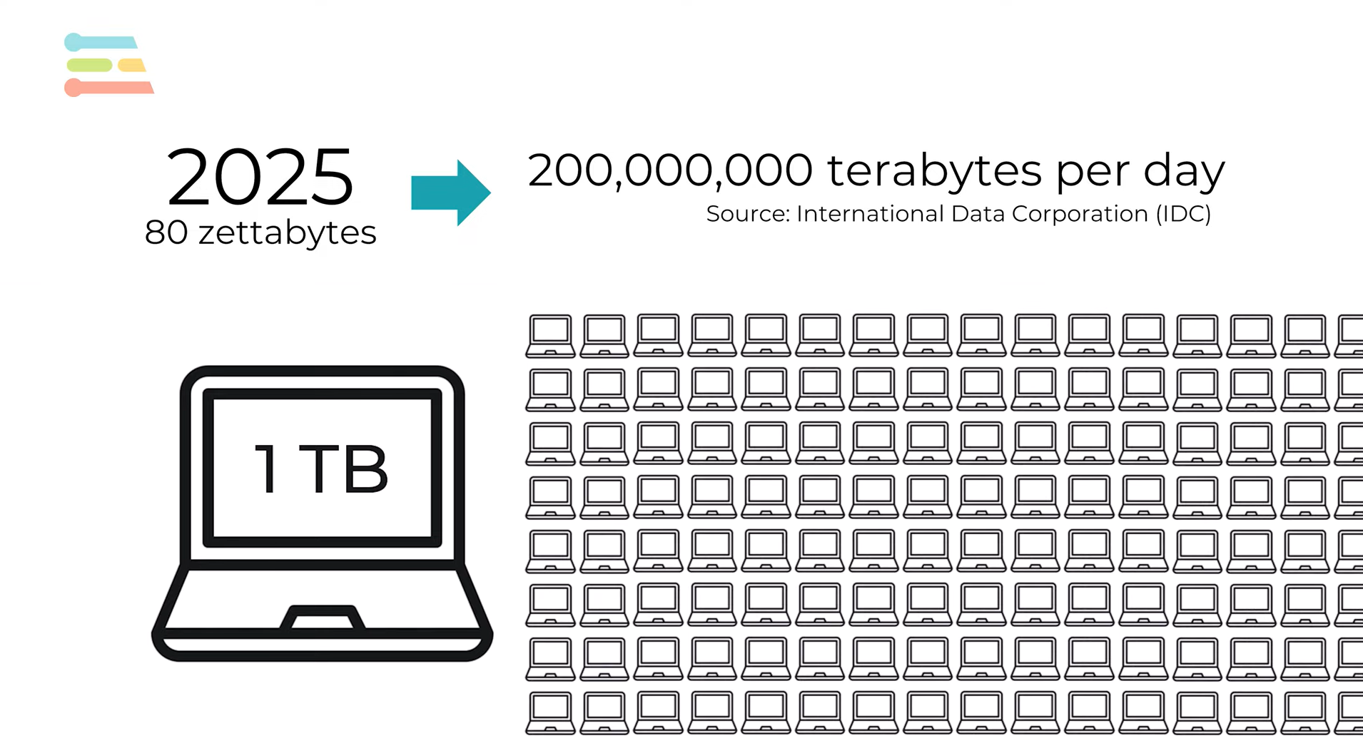
Why?
Notes:
It requires 200 million of Computer (1TB HD) per day!!!

Slide 24
How does edge computing work?
Upstream applications
Upstream applications prioritize collecting data from smart sensors and other devices, then transmitting it to data centers for further processing.
only transmits critical information to the data center.
Downstream applications
Downstream applications prioritize data delivery to end users.
Examples include live video streaming in media and entertainment, online gaming, or virtual reality video feeds.
Edge computing for downstream use cases focus on reducing network latency so users experience events as they take place.
content delivery network (CDN) is an example

Slide 25
Comparison of Computing Models
Early computing | Applications run only on one isolated computer
Personal computing | Applications run locally either on the user’s device or in a data center
Cloud computing | Applications run in data centers and processed via the cloud
Edge computing | Applications run close to the user; either on the user’s device or on the network edge

Slide 26
Edge computing – an example
Consider a building secured with dozens of high-definition IoT video cameras. These are ‘dumb’ cameras that simply output a raw video signal and continuously stream that signal to a cloud server. On the cloud server, the video output from all the cameras is put through a motion-detection application to ensure that only clips featuring activity are saved to the server’s database. This means there is a constant and significant strain on the building’s Internet infrastructure, as significant bandwidth gets consumed by the high volume of video footage being transferred. Additionally, there is very heavy load on the cloud server that has to process the video footage from all the cameras simultaneously.
Notes:
Eg – Smart Glucometer Kit with Mobile App, Smart Wristwatches, Fitbit Band for Oxygen Saturation Level (SpO2), Heart Rate Etc with Health Metrics App via bluetooth

Slide 27
.......Continue
Now imagine that the motion sensor computation is moved to the network edge. What if each camera used its own internal computer to run the motion-detecting application and then sent footage to the cloud server as needed? This would result in a significant reduction in bandwidth use, because much of the camera footage will never have to travel to the cloud server. Additionally, the cloud server would now only be responsible for storing the important footage, meaning that the server could communicate with a higher number of cameras without getting overloaded. This is what edge computing looks like.

Slide 28
Smart Home Devices
Implementation: Edge computing is effectively utilized in smart home devices.
Scenario: In smart homes, numerous IoT devices gather data throughout the house.
Data Handling: Initially, data is sent to a remote server for storage and processing.
Challenges: This centralized architecture can lead to issues during network outages.
Edge Computing Benefits: By deploying edge computing, data storage and processing are brought closer to the smart home.
Advantages: Reduces backhaul costs and latency, ensuring continuous operation even when the network is down.

Slide 29
Cloud Gaming Industry
Application: Edge computing is employed in the cloud gaming sector.
Objective: Cloud gaming companies aim to position their servers as close as possible to gamers.
Purpose: This approach minimizes lags and enhances the overall gaming experience, providing gamers with an immersive gameplay environment.

Slide 30
Edge Computing in Social Good
Environmental factors like road traffic density, air quality, weather, school holidays, and other open data sets give better results by the processing of data with the help of edge computing and machine learning.
The computing power will apply these factors to the data collected from healthcare at the point of admission, where data to be set where the patient expected to be discharged.
There is also a movement from businesses in all sectors to use edge computing.

Slide 31
Edge Computing Use Cases in Manufacturing
Use Case | Description
Condition-based Monitoring | Enables manufacturers to access data from machines and systems and to filter it to reduce server overload. This also allows remote asset condition monitoring, potentially generating new revenue streams through maintenance services or managed services for uptime.
Predictive Maintenance | Pre-emptive machine failure detection through data analytics, enabling maintenance before potential breakdown. Edge computing allows processing of data close to the end-device, thus saving data transportation costs and ensuring reliable data access.
Manufacturing-as-a-service | Edge computing allows for flexibility and mobility in manufacturing, creating more sharing models and overcoming data security concerns. It enables efficient setup of temporary sites and faster response to changing customer demands.
AR/VR in the Manufacturing Plant | Employment of augmented/mixed/virtual reality for training, health and safety, remote expertise, and quality inspections. Edge computing overcomes latency issues and makes VR headsets more user-friendly.
Precision Monitoring and Control | Real-time adaptation of the manufacturing process using data from multiple sources. Edge computing is critical for collecting, aggregating and filtering the data, and for training and executing AI/ML algorithms, distributing processing across multiple edges rather than solely in the cloud.
Notes:
https://stlpartners.com/articles/edge-computing/edge-computing-manufacturing-use-cases/

Slide 32
Edge Computing in Healthcare
As we know, edge allows us to manage your connectivity and disperse processing closer to where data is, the advantage is a natural evolution when you optimize some part of your stack in the network with giving more localized services for your application.
Moving the analysis of clinical information to edge computing is crucial for healthcare organizations that want to benefit from going digital and the key to digital healthcare problems.
For example, in the hospital, we collect data from IoT devices, which is monitoring patients and transfer it to the trust’s electronic health record (EHR) from the bedside, with the authentication of staff to the IoT devices through proximity cards.

Slide 33
Cases of Edge Computing
Security system monitoring: As described in the CC Camera system.
IoT devices: Smart devices that connect to the Internet can benefit from running code on the device itself, rather than in the cloud, for more efficient user interactions.
Self-driving cars: Autonomous vehicles need to react in real time, without waiting for instructions from a server.
●●●

Slide 34
Cases of Edge Computing
More efficient caching: By running code on a CDN edge network, an application can customize how content is cached to more efficiently serve content to users.
Medical monitoring devices: It is crucial for medical devices to respond in real time without waiting to hear from a cloud server.

Slide 35
Benefits
As seen in the example above, edge computing helps minimize bandwidth use and server resources. Bandwidth and cloud resources are finite and cost money. With every household and office becoming equipped with smart cameras, printers, thermostats etc. and as per Statistical predicts that by 2025 there will be over billion IoT devices installed worldwide. In order to support all those devices, significant amounts of computation will have to be moved to the edge.

Slide 36
.....Benefits
Another significant benefit of moving processes to the edge is to reduce latency. Every time a device needs to communicate with a distant server somewhere, that creates a delay. For example, two co-workers in the same office chatting over an Internet Messaging platform might experience a sizable delay because each message has to be routed out of the building, communicate with a server somewhere across the globe, and be brought back before it appears on the recipient’s screen. If that process is brought to the edge, and the company’s internal router is in charge of transferring intra-office chats, that noticeable delay would not exist.

Slide 37
....Benefits
Similarly, when users of all kinds of web applications run into processes that have to communicate with an external server, they will encounter delays. The duration of these delays will vary based upon their available bandwidth and the location of the server, but these delays can be avoided altogether by bringing more processes to the network edge.

Slide 38
....benefits
In addition, edge computing can provide new functionality that wasn’t previously available. For example, a company can use edge computing to process and analyze their data at the edge, which makes it possible to do so in real time.

Slide 39
Key benefits (Summary)
Decreased latency
Decrease in bandwidth use and associated cost
Decrease in server resources and associated cost
Added functionality

Slide 40
Security in Edge Computing
There are two sides of security in edge computing –
One of them is that the security in edge computing is better than any other part of the data storage application because data is not traveling over the network; it stays where it is created.
The flip side of it is that security in edge computing is less secure because the edge devices in themselves can be more vulnerable.
In conclusion, data encryption, access control, and the use of virtual private networks are crucial elements to protect the edge computing system.

Slide 41
Drawback
It can increase attack vectors. With the addition of more ‘smart’ devices into the mix, such as edge servers and IoT devices that have robust built-in computers, there are new opportunities for malicious actors to compromise these devices.
It requires more local hardware. For example, while an IoT camera needs a built-in computer to send its raw video data to a web server, it would require a much more sophisticated computer with more processing power in order for it to run its own motion-detection algorithms. But the dropping costs of hardware are making it cheaper to build smarter devices.

Slide 42
Thank You

Slide 43
How Edge Computing is Relevant for Industry 4.0?

